Slide 1


Implementation of ID3 Decision Tree Algorithm
Chi Shao – Student ID 12964235

Slide 2
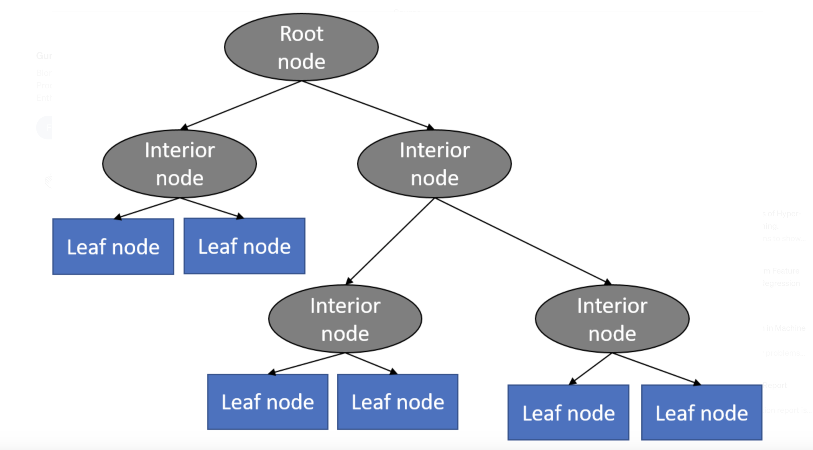
What is ID3 and more specifically what is a Decision Tree?
ID3 namely Iterative Dichotomiser 3 is an algorithm used to generate a decision tree from a given dataset
A Decision Tree is a type of supervised model (meaning there is a given class or outcome to predict) where it explains what the input (feature variables) is and what the outcome (class) is in the training dataset where these data are continuously split according to certain parameters to achieve maximum gains
Node present at the beginning of a decision from this the population starts dividing given different parameters
Internal node or split nodes are test conditions and from then we follow the appropriate branch based on the outcome of these tests this can either lead to more interior nodes or an outcome
Leaf node is the output, this is the final prediction

Slide 3
What are the steps of implementing an ID3 Algorithm
Calculating Entropy
Calculate information gain
Find Feature with maximum information gain
Repeat process until no more gains to achieve desired tree

Slide 4
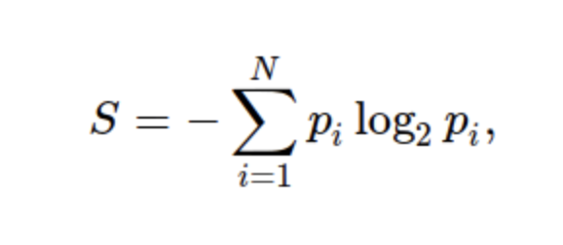
Entropy - Measure of the amount of uncertainty in the dataset
N = number of classes in target
Pi = probability of class i
Using the IRIS dataset we can manually calculate the Entropy of our class (flower type)
The dataset consists of 150 records where each class have 50 records
Hence Entropy(Class) = -(0.33*log2(0.33))-(0.33*log2(0.33))-(0.33*log2(0.33)) = 1.585
Entropy(Class) = 1.585 is a high entropy, which means high level of purity. If entropy = 0 this means, there is only 1 class.

Slide 5

Information Gain – The process in selecting the best feature at each step - It is essentially a weighted measurement of entropy and is used to determine decision node splitting in ID3 algorithms, the variable with the highest information gain is selected to split the dataset
Information gain is represented by the formulae
Information Gain (Class, Attribute) =
Entropy (Class) - ($P\left(Class | Attribute\right) X Entropy(Class|Attribute)$)
The values in Petal Length are (1,2,3,4,5,6,7), we calculate the entropy of each of these values, using the same formulae as previous, for petal length = 1 then entropy = 0.41
Then calculate the probability of these values occurring, e.g., if Petal Length 1 the probability is 22/150 hence 0.15
Then calculate the weighted entropy value which is Entropy * Probability hence (0.41*0.15) = 0.06
Apply the Information gain formulae – I.G = Total Entropy – sum (weighted entropy) in our case it will be 1.585 – 0.44 = 1.14

Slide 6
Model Evaluation – What does my tree look like?
Tree
Petal Length (1,2)
Iris-Setosa
Petal Length (3,4)
Iris-Versicolour
Petal Length (5)
Petal Length (6,7)
Petal Width (1)
Iris - Virginica
Iris-Versicolour
Petal Length (2)
Sepal Length (6)
Septal Width (2,3)
Iris - Virginica
Sepal Length (7)
Sepal Width (3)
Iris - Virginica

Slide 7
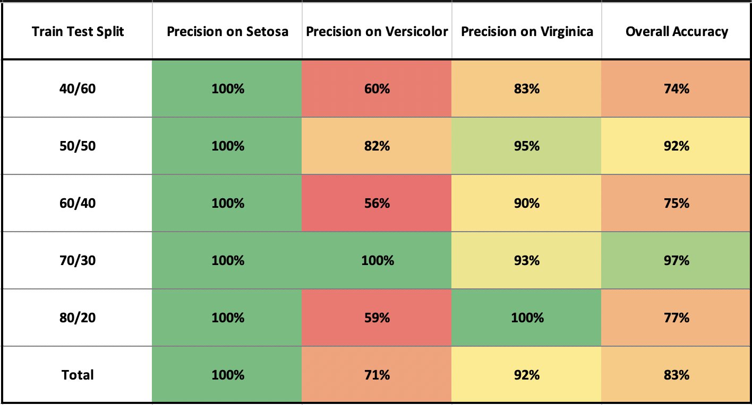
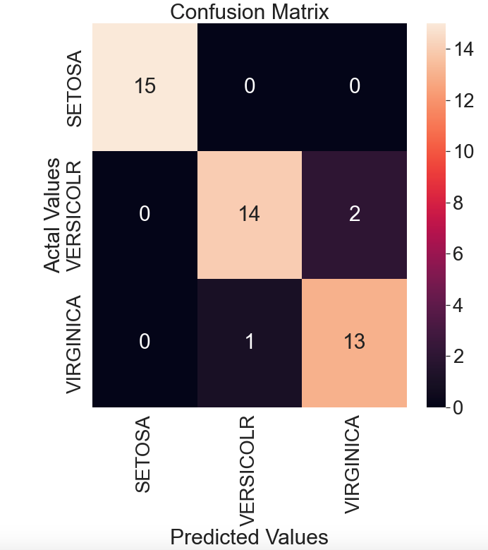
Model Evaluation – What does my tree look like?
Overall, the accuracy of the model fluctuates between 75% to 97%, there doesn’t seem to be any correlation between increase in training data and accuracy of the model. The best prediction is for class Setosa, which the prediction was always right on any given splits. The worse prediction was Versicolor, where the average of accuracy was 71% compared with 100% and 92% on other classes.

